Slide 1

Manu Benny
Rajesh Bhandari
Teja Sri Lakshmi Ganesh Balaji Bokka Madeleine Breitkreutz
Atif Harshad
Jannis Römermann
11 May 2023
Team C-rious
Milestone 2

Slide 2
2/13
Content
Stochastic Petri net model
Assumptions and Justifications
Quantities to be Measured
Quantities in simulation result
Experiments List
Cost Analysis and progress
Lessons Learned

Slide 3
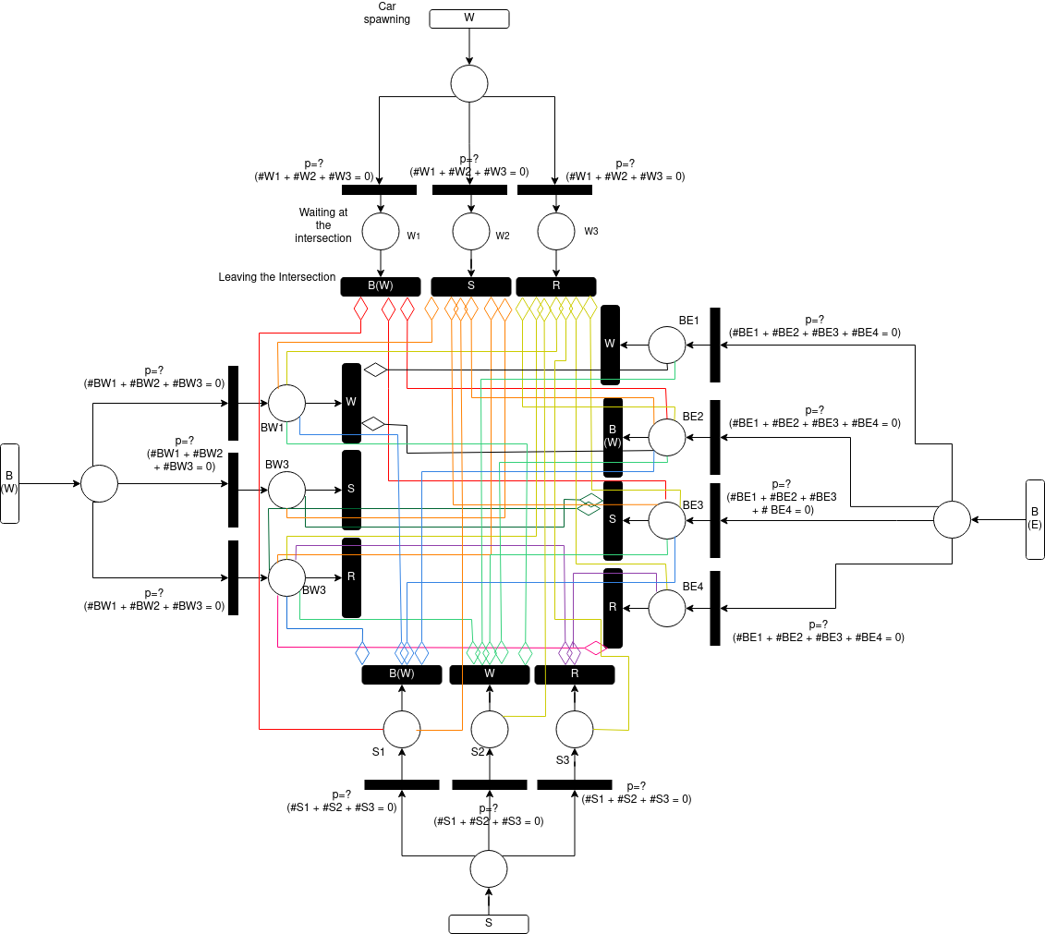
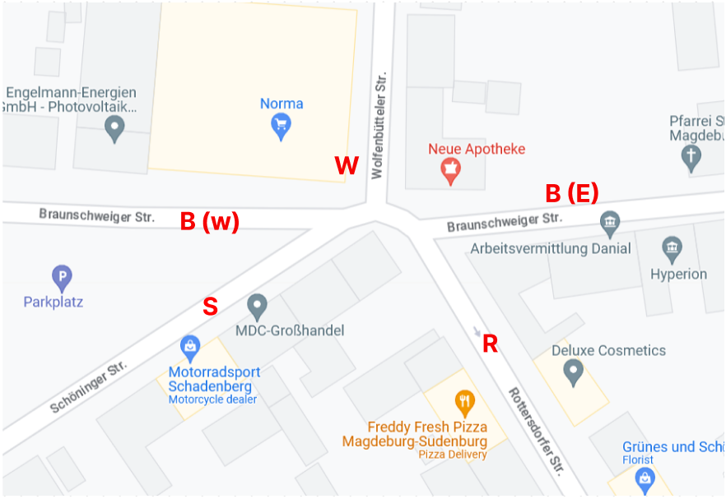
3/13
Stochastic Petri net model
Tool : draw.io

Slide 4
4/13
Stochastic Petri net model
Vehicles come from Braunschweiger Straße West (B(W))*, Schöninger Straße (S)*, Wolfenbüttler Straße (W)* or Braunschweiger Straße East (B(E))
( * - Two-way Roads)
Vehicles cannot come from Rottendorfer Straße (R) as it’s One-way.
Every street except Rottendorfer Straße (R) can spawn a vehicle.
The vehicle then determines where it wants to travel based on a probability and only if no other vehicle is waiting (as guaranteed by the guardian function).
If the vehicle is not held back by another car (which is allowed to move first) then it immediately leaves the intersection.

Slide 5
5/13
Assumptions and Justifications
Simplification: The vehicle leaves the system without using time transition because the petri net becomes way more complex without gaining anything useful from it.
Everything on the street is a vehicle.
Pedestriants are not considerd into our simulation. As it implies to a small amount from the existing data.
We also assume that our vehicle will drive according to the rules which is not always a given.

Slide 6
6/13
Quantities to be Measured
Troughput (number of units)
Waiting time
Inter-arrival time
Total turns in any direction

Slide 7
7/13
Quantities in simulation results
Troughput (number of units)
Waiting time
Total time

Slide 8
8/13
Experiments List
1) Current System VS Five-way roundabout
(waiting time and troughput)
2) Five-way roundabout VS Four-way roundabout
(waiting time and troughput)
3) Current System VS both Roundabouts:
Which can clear a traffic jam fastest?
4) With x* the amound of traffic, Current System VS Five-way roundbaout (waiting time and troughput)

Slide 9
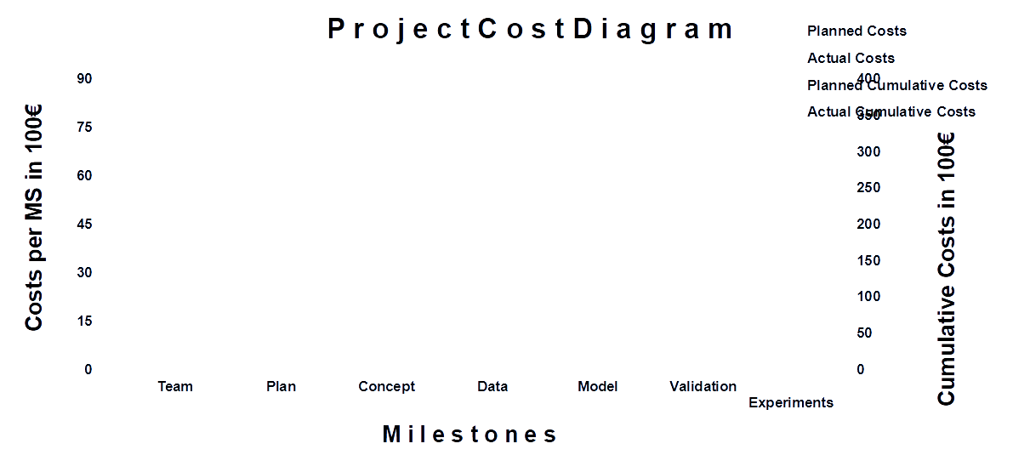
9/13
Cost Analysis

Slide 10
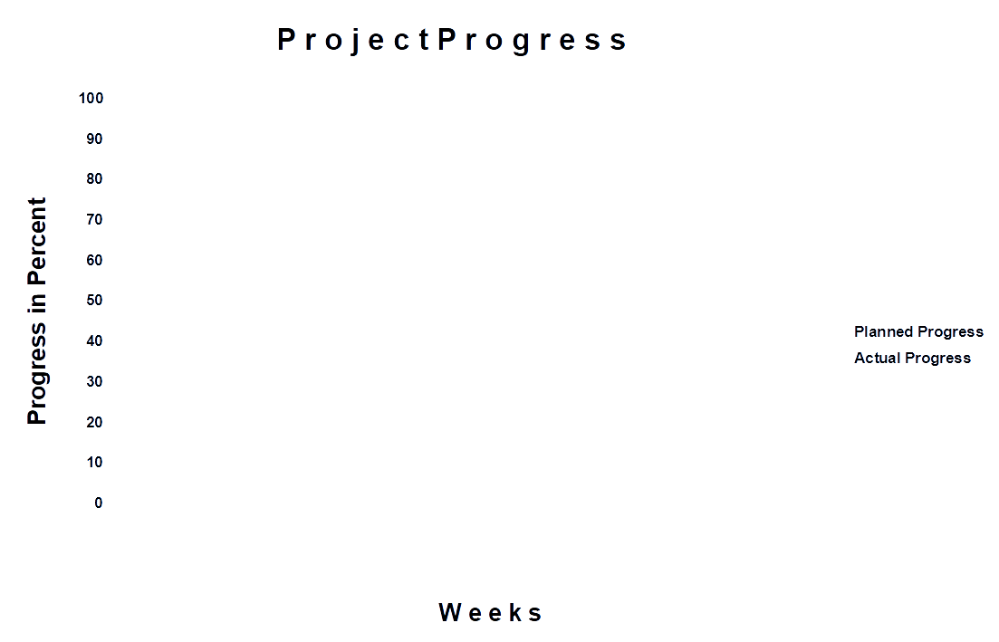
9/13
Project Progress

Slide 11
10/13
Lessons Learned
Conceptual Model is often an iterative process that involves feedback
Different kind of plans are good for different things
Keep the model open, to integrate any new idea (later into the project)
A better conceptual model reduces labour load by reducing unnecessary data to examine and work with.

Slide 12

11/13
Any Questions?
?
?
?

